Slide 1


Slide 2


Slide 3
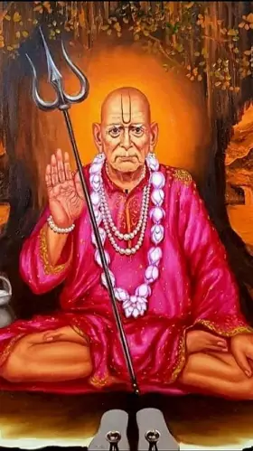

Slide 4
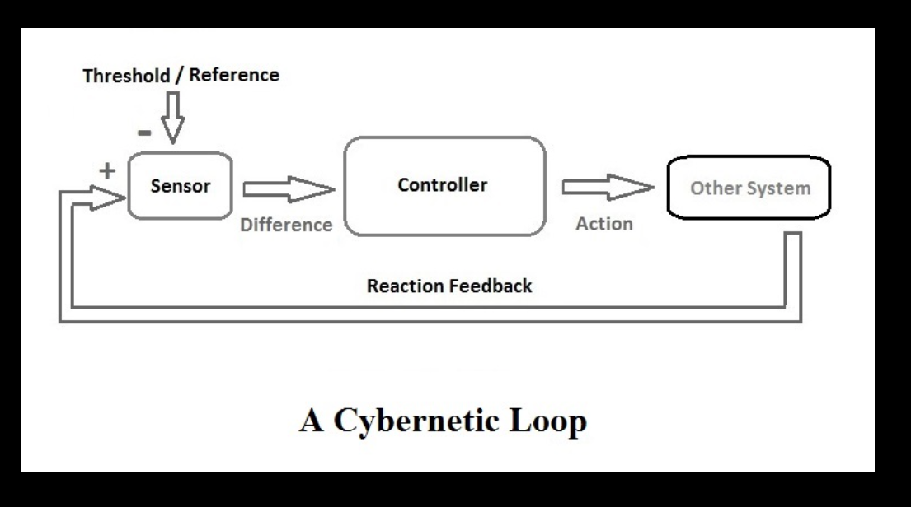

Slide 5
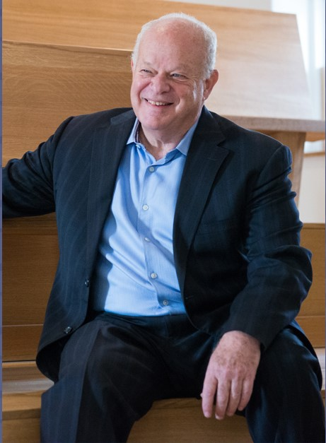
Temporary
Specific
External

Slide 6
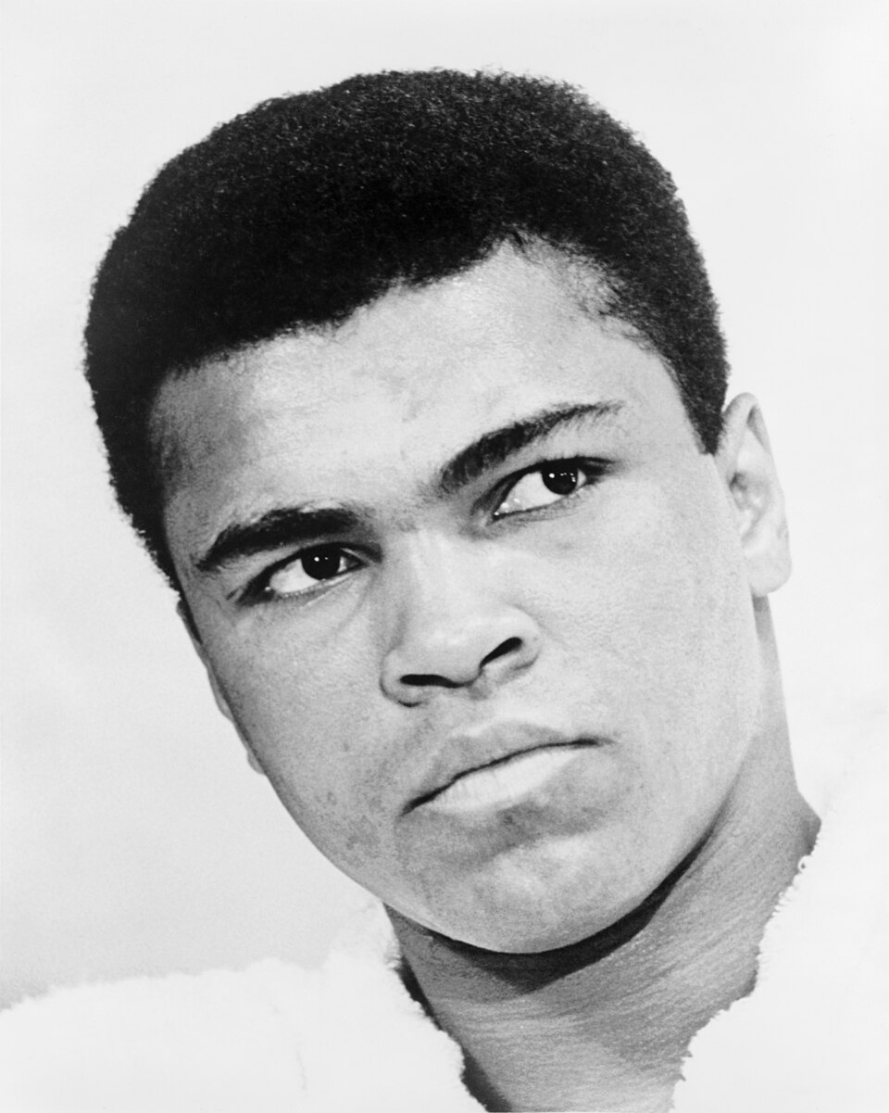

Slide 7


Slide 8
Relaxation + Anxiety

Slide 9
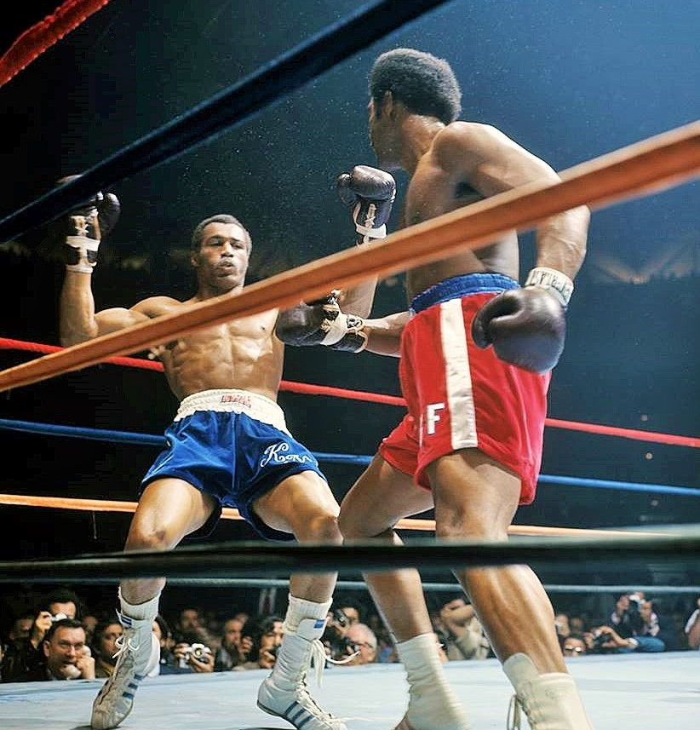

Slide 10
1 . Coaches
2 . Losing
3 . Mistakes

Slide 11
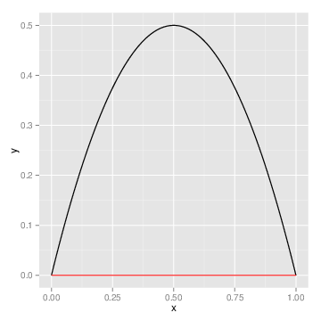

Slide 12


Slide 13
DEEP MUSCLE RELAXATION

Slide 14


Slide 15
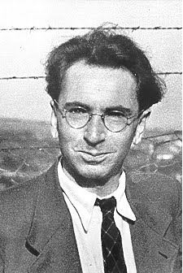

Motivation

Slide 16
Fighter
Warrior
Social Worker

Slide 17
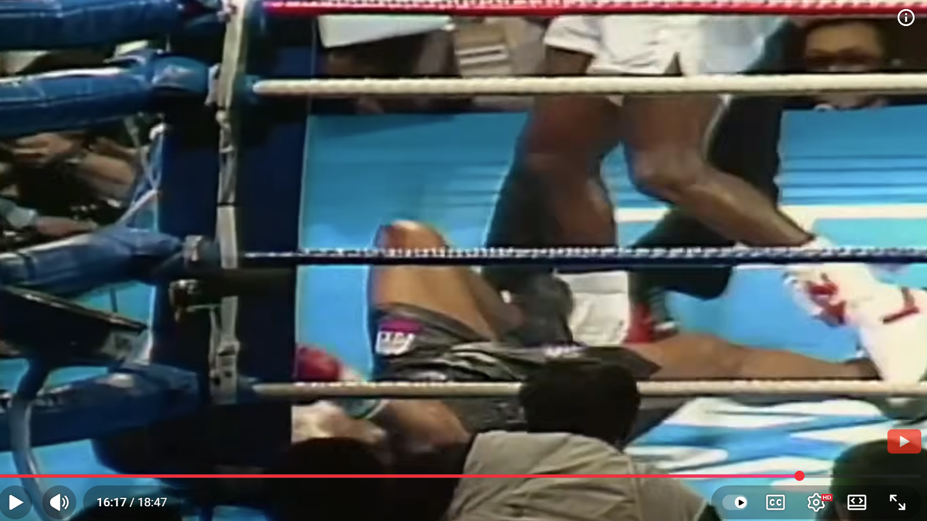
16:00
https://youtu.be/1YPEsVHNUlk

Slide 18
SMART

Slide 19
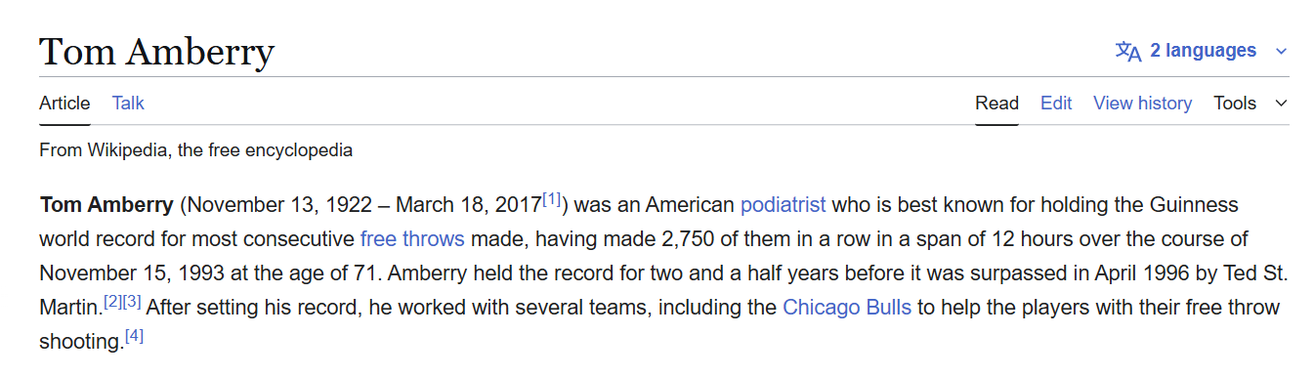

Slide 20
