Slide 1

Did I Do That (Create a Title Problem)?
By: Margo Dugas (MD Title) & Katie Belanger (FNF Family of Companies)

Slide 2

Authentic Act
CC art. 1833. A. An authentic act is a writing executed before a notary public or other officer authorized to perform that function, in the presence of two witnesses, and signed by each party who executed it, by each witness, and by each notary public before whom it was executed.
Required for donations and mortgages (executory process)
Preferred for all real estate transactions

Slide 3
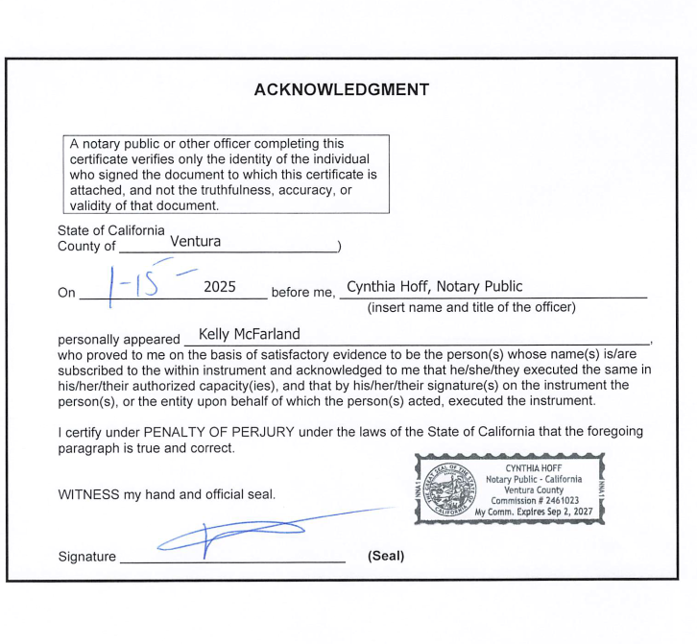


Slide 4
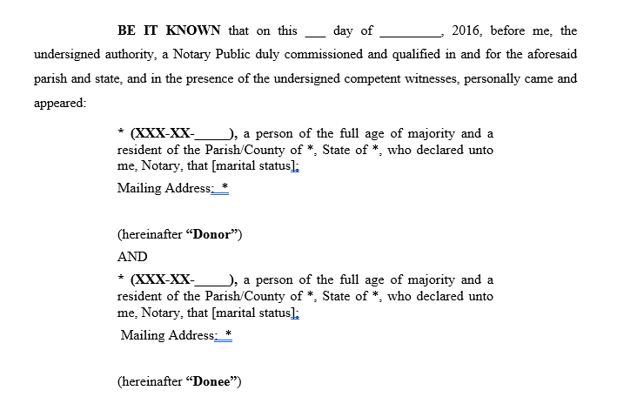
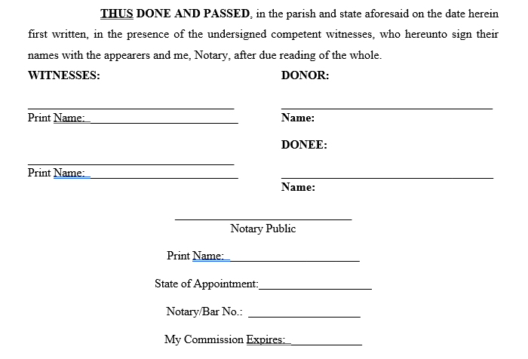
Authentic Act

Slide 5
Community Property
Art. 2342. Declaration of acquisition of separate property
A. A declaration in an act of acquisition that things are acquired with separate funds as the separate property of a spouse may be controverted by the other spouse unless he concurred in the act. It may also be controverted by the forced heirs and the creditors of the spouses, despite the concurrence by the other spouse.
B. Nevertheless, when there has been such a declaration, an alienation, encumbrance, or lease of the thing by onerous title, during the community regime or thereafter, may not be set aside on the ground of the falsity of the declaration.
APPEARANCE CLAUSE
Jane Sarah Smith (XXX-XX-1234), an individual of the full age of majority, married once and then to Michael Anthony Scott, with whom she currently resides at 123 Front Street, Houma, LA 70360, acquiring herein with her separate funds as her separate property.
INTERVENTION
AND NOW HERE COMES, Michael Anthony Scott, spouse of Jane Sarah Smith, who acknowledges that the property acquired herein is acquired with the separate funds of Jane Sarah Smith, and shall be the separate property of Jane Sarah Smith.
PRACTICE TIP
Use this when acquiring during the pendency of divorce.
Use this when buying siblings out of inherited property.
Use this for distributions from an entity that forms part of the separate estate of one spouse.

Slide 6
Community Property Partitions
Full legal description
Present tense transfer language
Waiver of resolutory conditions
Does it create a judicial mortgage?

Slide 7
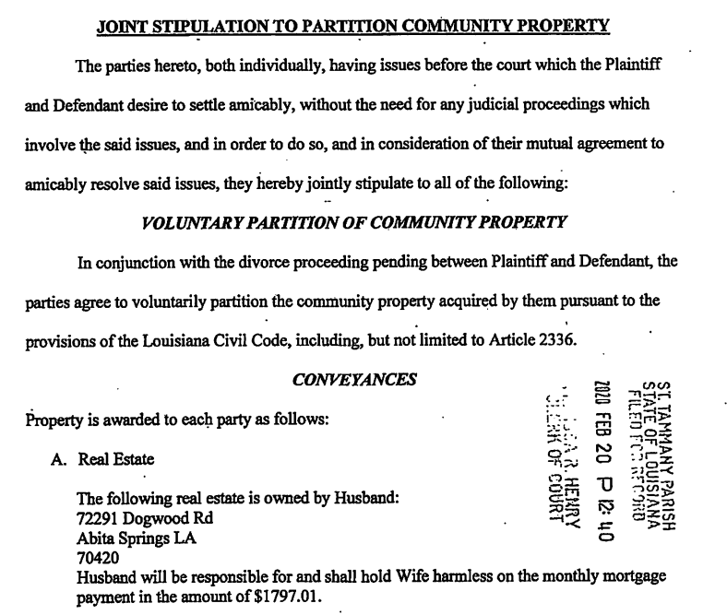

Slide 8
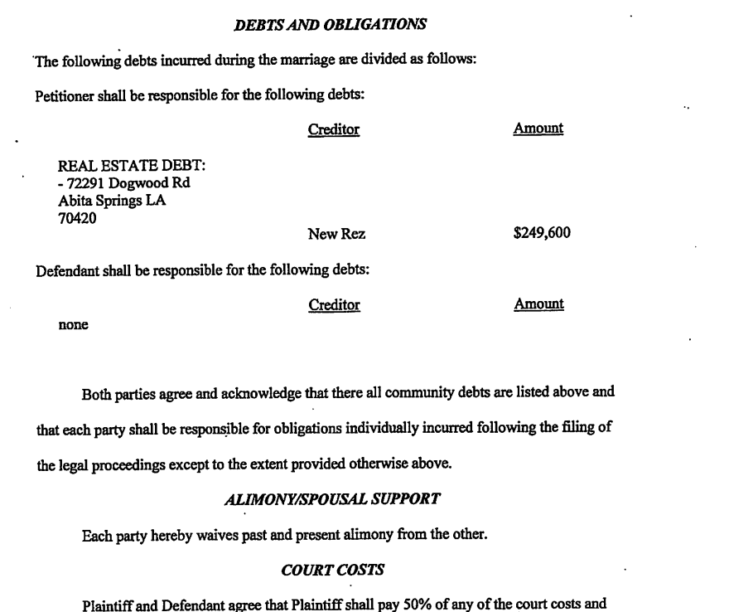

Slide 9
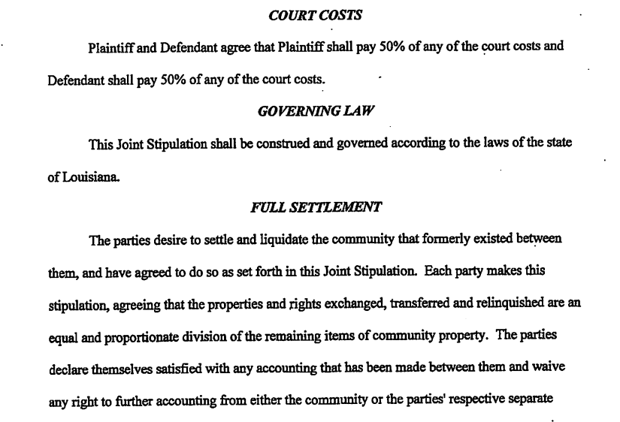

Slide 10
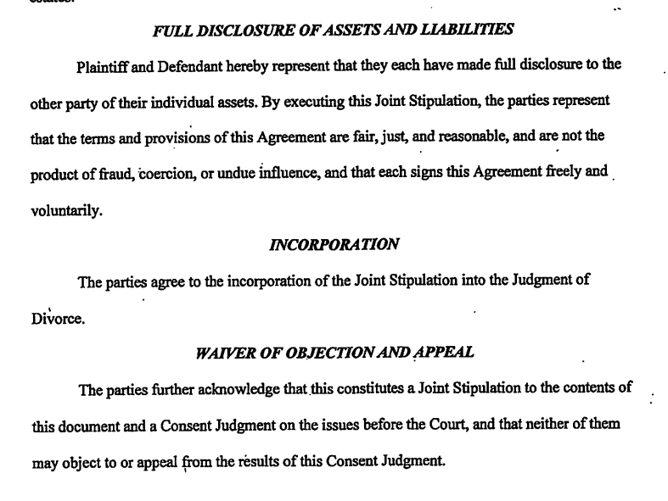

Slide 11
Minors & Immovable Property
DON’T PUT MINORS ON TITLE!!!
To Sell or Mortgage immovable property owned by a minor:
1. Appoint a tutor and undertutor.
2. Post bond or file a minor’s mortgage.
3. Petition the court for authority to sell the property.
Art. 322. Minor's legal mortgage on tutor's property.
The recording of the certificate of the clerk operates as a legal mortgage in favor of the minor for the amount therein stated, on all the immovable property of the natural tutor in the parish.
PRACTICE TIP
When possible, do not put a minor in possession of immovable property.
When petitioning for authority to sell, petition for the release of the minor’s mortgage.
Petition both to release minor’s mortgage from property being sold and subordinate to mortgage on property being acquired.

Slide 12
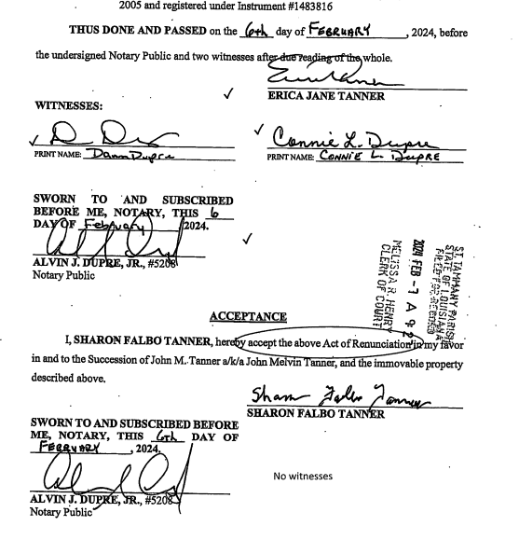
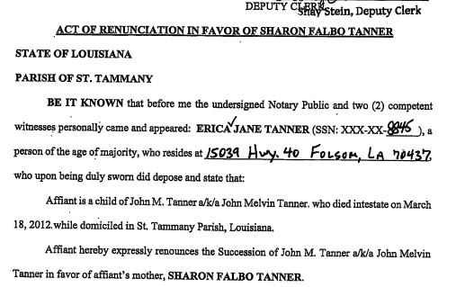
Renunciation of Succession

Slide 13
Renunciation of Successions
Property flows as if renouncing heir predeceased.
- Remember representation in descendant (CC art. 882) and sibling (CC art. 884) lines.
- Minors are presumed to accept a succession.
Donative renunciation is an acceptance and a donation.
- Run renouncing heir for judgments.
- Verify renunciation is in donative form (authentic act with acceptance by donee).
Cannot renounce within a small succession affidavit.
Consider independent administration in lieu of donative renunciation.

Slide 14
Trusts
Extract must be recorded
Title will review trust instrument
Good for minor’s property
Potential problem for reverse mortgage

Slide 15
Bankruptcy
La. R.S. 9:5175.1 authorizes an attorney to file an affidavit and request to cancel liens, judgments, mortgages, or privileges partially cancelled as to a particular property subject to a bankruptcy free and clear sale.
La. R. S. 9:5175 authorizes a partial cancellation of a judicial mortgage discharged in bankruptcy as to property acquired after the filing of the bankruptcy petition.
Discharge order does not cancel conventional or judicial mortgages or privileges against immovable property.
Inherited property is deemed acquired at date of decedent’s death.

Slide 16

Any Questions?

